Slide 1
Pattern Recognition with OpenMP
Parallel Computing
Alessandro Bianco 7147240
A.A. 2025/2026

Slide 2
Introduction
In an increasingly information-driven world, time series pattern recognition has become an essential tool for uncovering hidden trends, forecasting future events, and supporting data-driven decision-making.
Key applications of this approach span critical domains:
Healthcare
Social sciences
Finance and economics
…

Slide 3
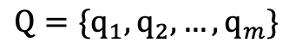
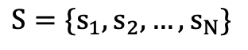
Problem Definition
The problem of pattern recognition applied to time series consists in identifying, within a set
of temporal sequences, the one that most closely resembles a reference sequence, known as the query. Formally:
$$S={\{s}_{1},s_{2},…,s_{N}\}$$
$$Q=\{q_{1},q_{2},…,q_{m}\}$$
where $S$ is the large time series of length N and Q is the reference sequence (i.e the query) of length $m≤N$

Slide 4
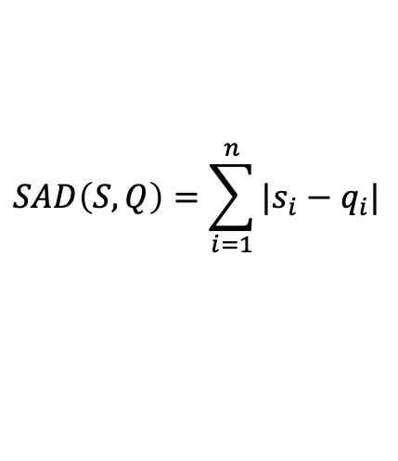
The Goal
The goal is to find the subsequence of S that minimizes a distance metric SAD(S,Q) with respect to Q. This distance (sum of absolute differences) can be expressed as:
$$SAD\left(S,Q\right)=\sum_{i=1}^{n}{|s_{i}−q_{i}|}$$
where the lower the SAD value, the greater the similarity between the analyzed series
and the query.

Slide 5
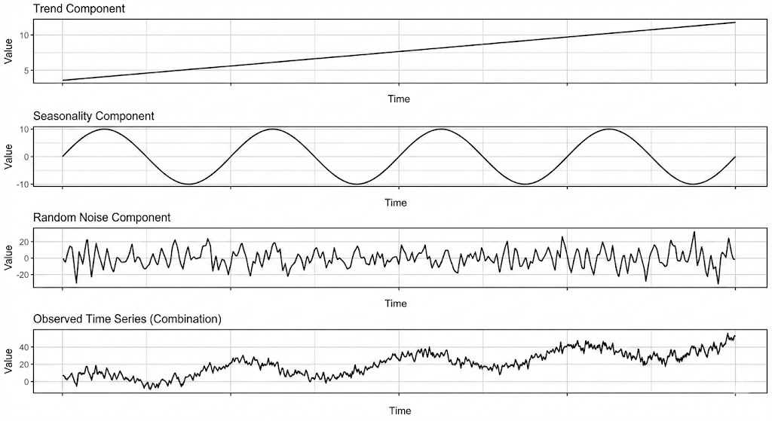
Dataset Generation
The dataset used in this project is generated using the mockseries Python library. A script is implemented to take as input the number of time series to generate, the length of each series, and the length of the query.
The time series generation algorithm creates synthetic sequences by combining three components:
Linear trend
Stagionalty
Random Gaussian noise

Slide 6
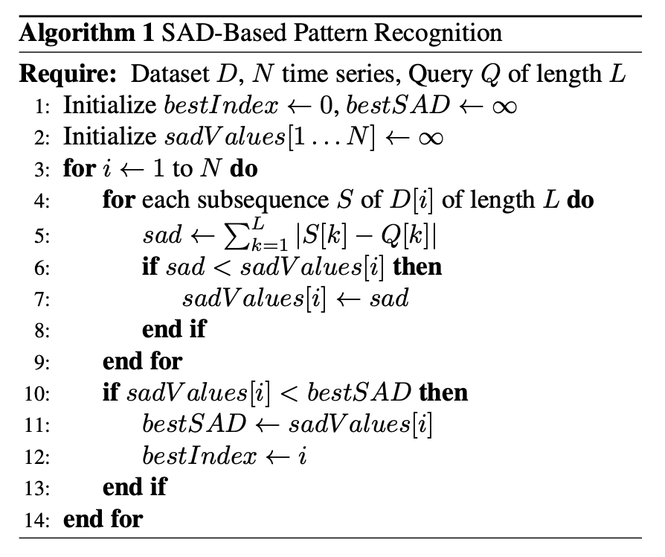
Sequential Implementation
SAD Computation
Inner Loop
Outer Loop

Slide 7
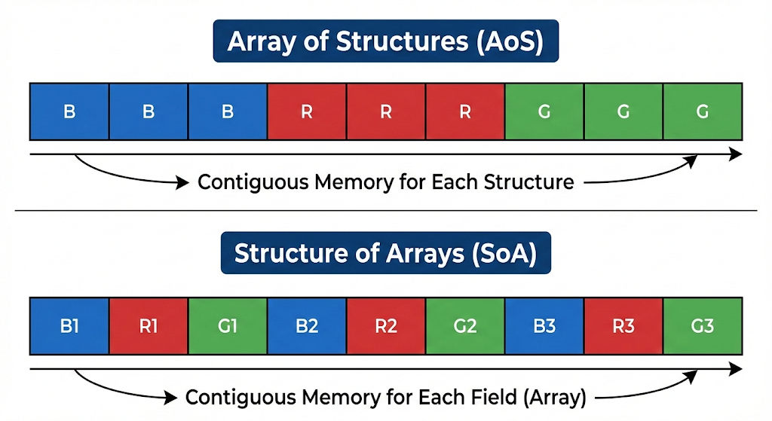
Memory layout: SoA vs AoS
SoA: Structure of Arrays
The values ​​of the series are stored in a vector of doubles, indexed by instants of time.
Each instant of time contains the values ​​of all the series, stored contiguously.
Operations on multiple series at the same instant read contiguous data, but penalizes sequential access due to memory jumps.
AoS: Array of Structures
Data stored via the Sample data structure which represents the single series.
Samples from the same series are contiguous in memory, optimizing sequential access.
Structure less suitable for parallel computation

Slide 8
Parallelization strategies
Two parallelized variants will be developed for both the AoS and SoA implementations. The aim is to investigate how parallelizing two different loops within the same algorithm can affect performance and determine the most suitable usage scenarios.
Outer Loop Parallelization
Inner Loop Parallelization
Inter-series
Intra-series
Iterates over the various time series in the dataset
Here we assign time series to different and separated threads
Scans each individual time series to compare it against the query
We maintain the sequential loop over the series but we parallelize the internal comparison between the series and the query

Slide 9
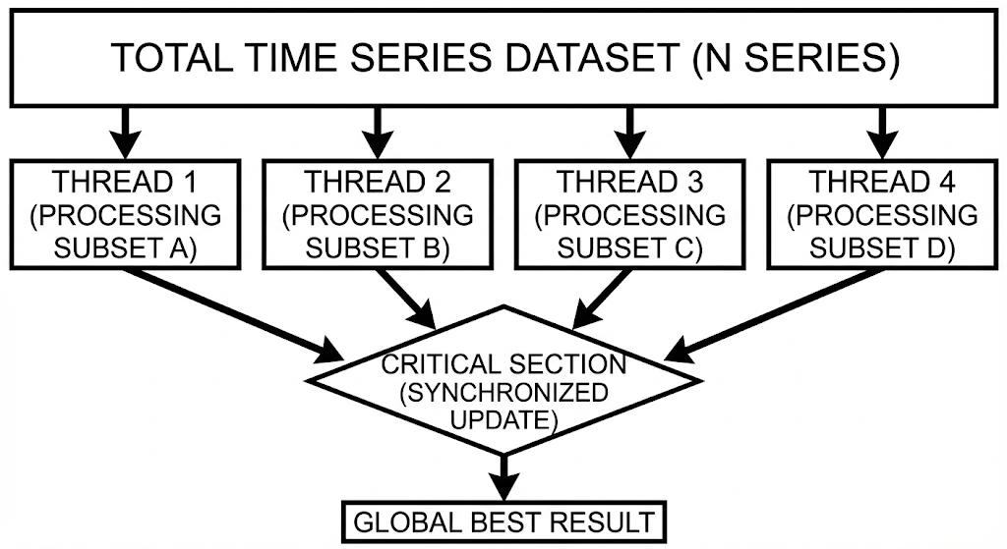
Outer Loop Parallelization
#pragma omp parallel for is applied to the outer loop for the time series iteration
bestSad value is efficiently managed via the reduction clause
bestIndex updates require a #pragma omp critical section to prevent race conditions

Slide 10
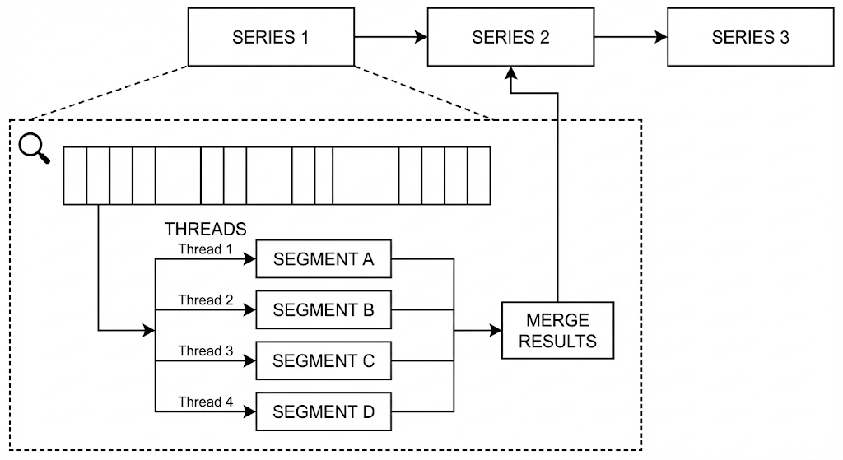
Inner Loop Parallelization
Outer loop remains sequential, and parallelism is applied strictly to the inner loop
For each time series a team of threads is spawned to compute SAD across all window positions
The global minimum is upddated sequentially by the main thread, eliminating the need for critical sections

Slide 11
Testing the implementations: Test suite
The tests to be carried out aim to determine which data structure can offer better performance
for each parallelization strategy, and how the size of the datasets to be analyzed may affect the effectiveness of the strategies (Inner vs. Outer).
Outer Parallelization Focused: Verify the effectivness of outer parallelization when there are many series to process in parallel, with reduced synchronization overhead
Inner Parallelization Focused: Test inner parallelization on very long series, where parallelism over the time steps should become more advantageous
# Series | Series Length | Query Length
1000 | 100 points | 50 points
5000 | 100 points | 50 points
# Series | Series Length | Query Length
10 | 5000 points | 50 points
5 | 10000 points | 50 points

Slide 12
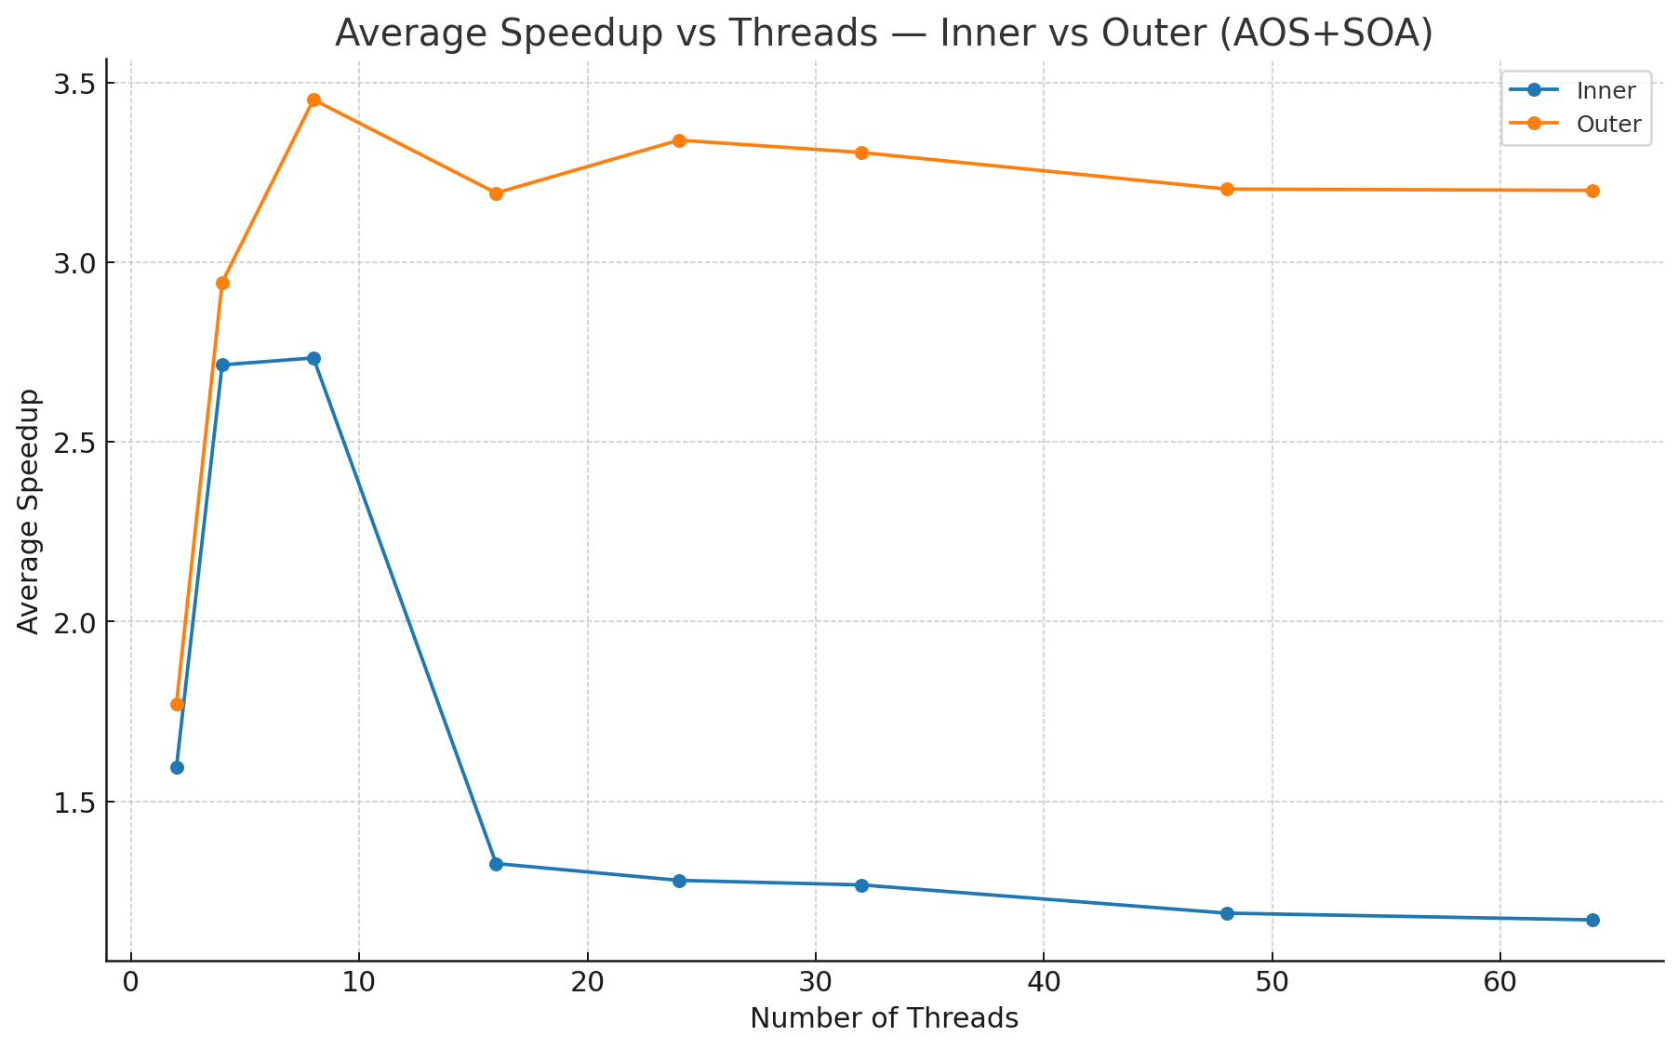
Test Results: Inner vs Outer
Outer-loop parallelization delivers the highest speedup due to independent workloads and low overhead.
Inner-loop parallelization degrades beyond 8 threads because of overhead and false sharing.
Both approaches hit a performance plateau caused by memory bandwidth saturation.

Slide 13
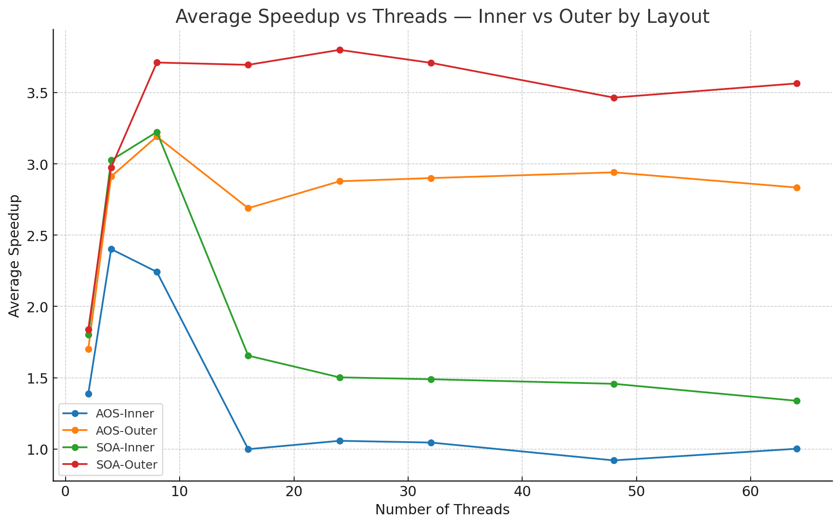
Test Results: Memory Layouts
SoA is the most efficient layout for parallel computation, but SoA–Inner degrades rapidly.
AoS–Outer, despite a less optimal memory layout, maintains better performance at high thread counts.
The benefits of SoA’s contiguous memory accesses are canceled by the synchronization and thread-management overhead of inner parallelization.
The coarse-grained nature of outer parallelization compensates for the scattered memory accesses of AoS.

Slide 14
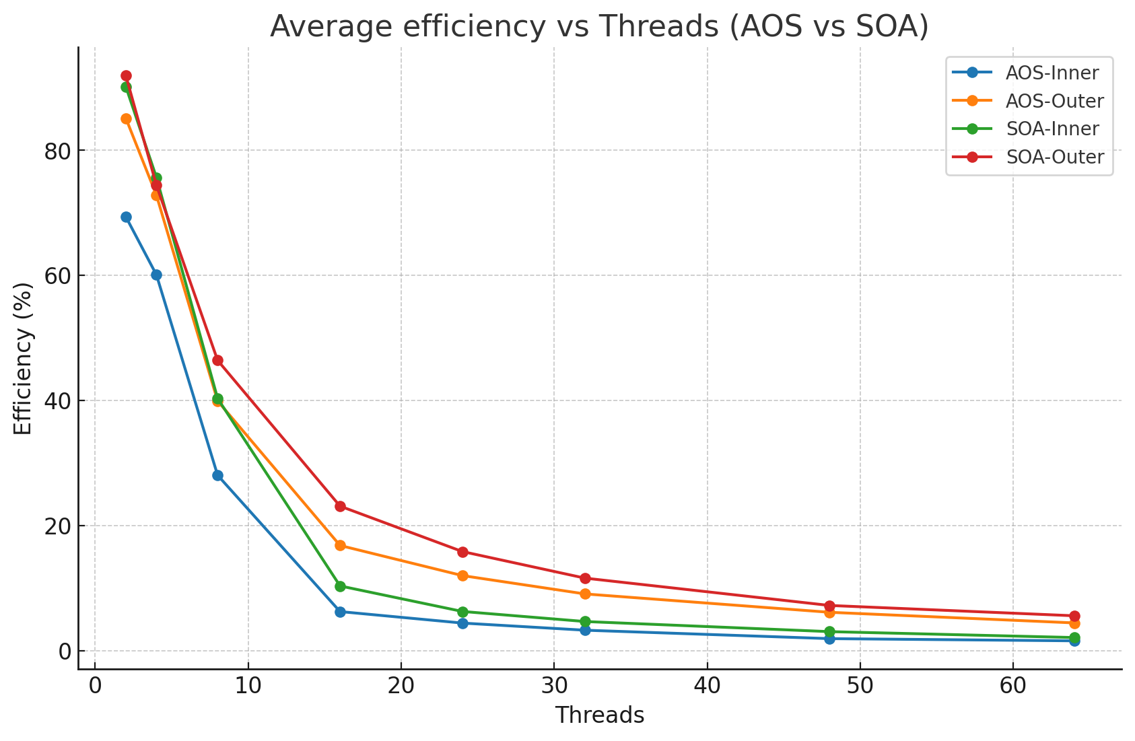
Test Results: Efficency
All curves show a rapid decline as the number of threads increases, in accordance with Amdahl’s Law.
As parallelism grows, synchronization and thread-management overhead becomes dominant over useful computation time.
The Outer configuration maintains higher efficiency thanks to its embarrassingly parallel nature.
The Inner configuration degrades more rapidly as thread count increases.

Slide 15
Conclusions
Strategy: Outer Dominates Inner
Outer Parallelization scales best by minimizing synchronization, while the inner strategy suffers from high overhead (barriers, false sharing) and poor data locality.
Layout: SoA Outperforms AoS
SoA is systematically more efficient in parallel due to contiguous, cache-friendly memory access while
AoS remains competitive mostly in sequential scenarios.
Hardware Limits:
Performance plateaus beyond 8–16 threads due to bandwidth saturation and efficiency drops monotonically, consistent with Amdahl’s Law.

Slide 16
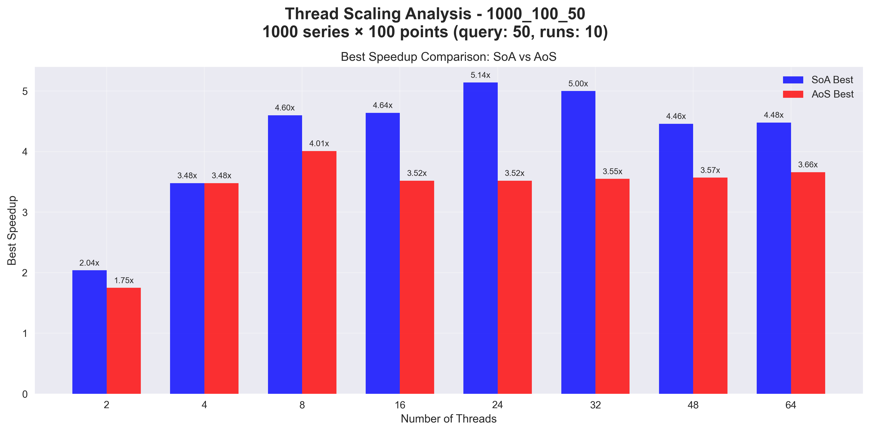
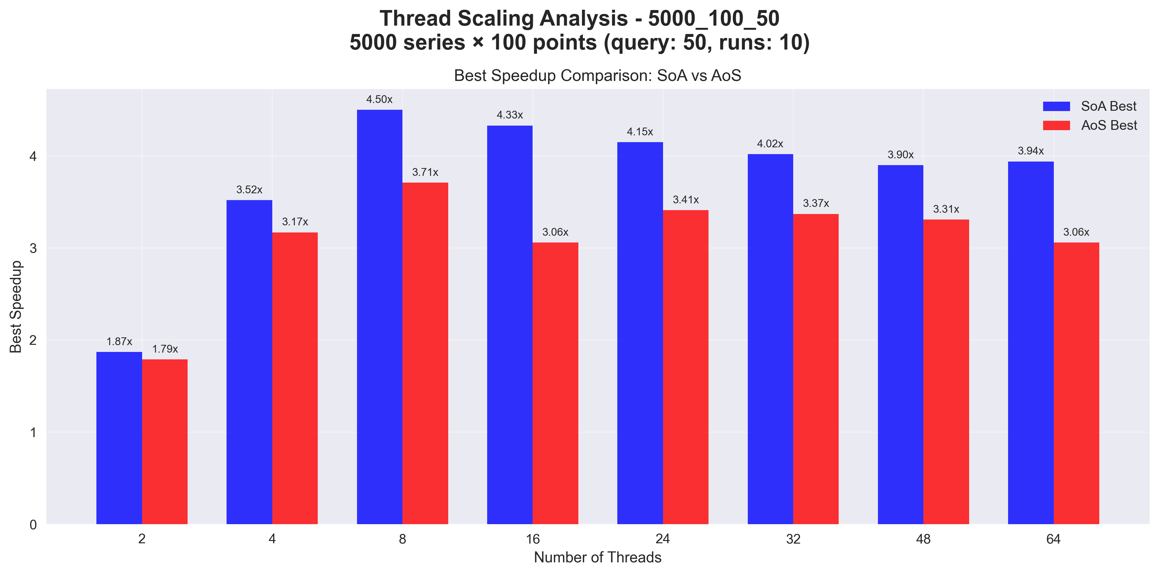
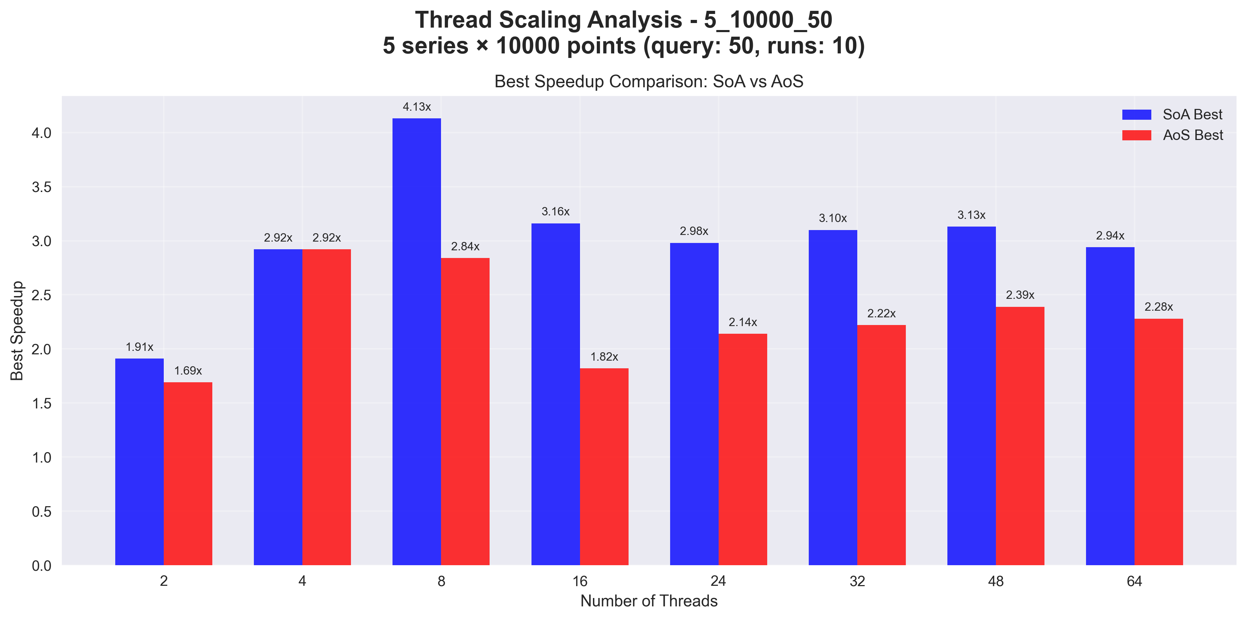
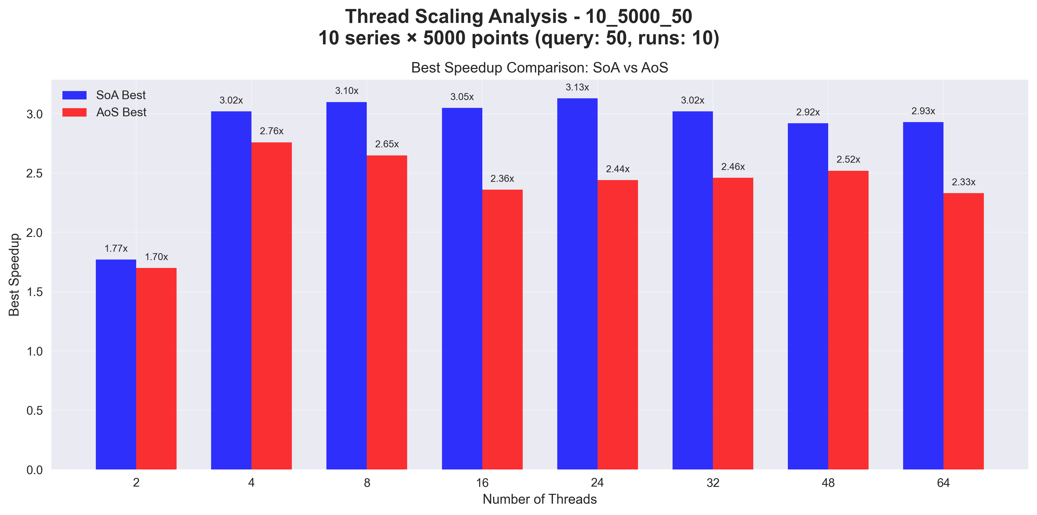
Test Results

